Slide 1


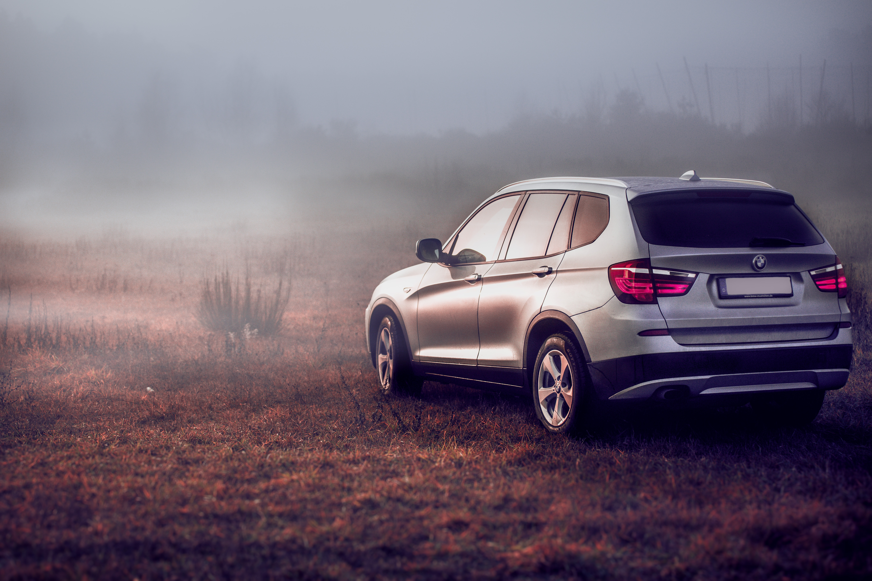

BMW vs. Volvo
Comparative Brand analysis
Neidhardt communications, 2023. All Rights Reserved

Slide 2
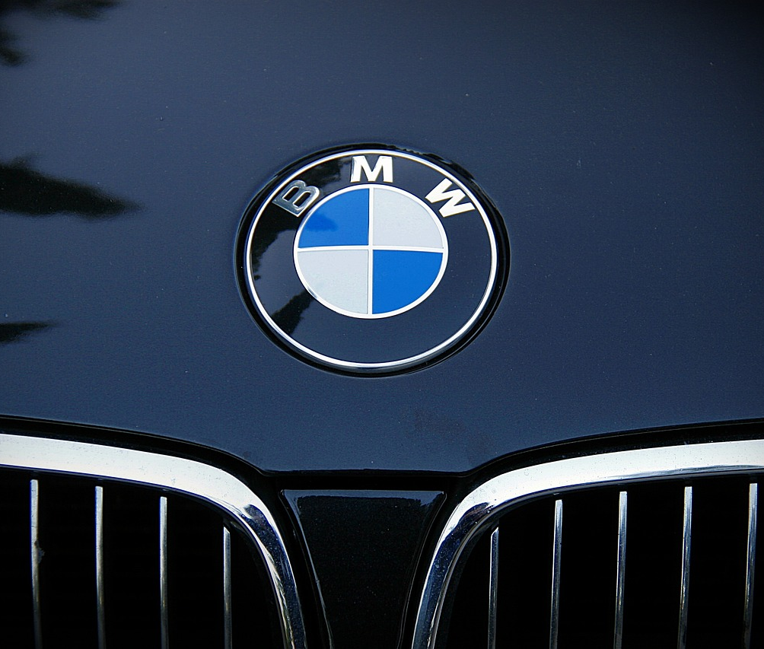
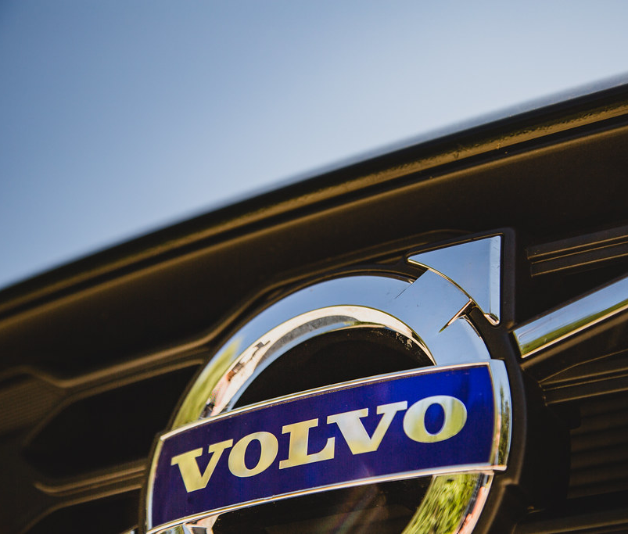
Brand Essence
A “Sheer Driving Pleasure”
“Safety” is its Essence
This Photo by Unknown Author is licensed under CC BY-SA

Slide 3
Executive Summary
Comparative brand analysis: BMW vs. Volvo

Slide 4
BMW vs. Volvo Brand Analysis
Introduction
This report presents a comparative analysis of the brand architectures of BMW and Volvo in the luxury automobile market. BMW and Volvo are renowned manufacturers known for their emphasis on safety, quality engineering, and premium vehicles. They cater to consumers who value high performance, luxury, and exceptional craftsmanship in their cars. Through an examination of their brand architectures, this report aims to provide valuable insights into their brand positioning, target market, market cap, product engineering, and overall brand identity.

Slide 5
BMW vs. Volvo Brand Analysis
Brand Architecture | BMW | Volvo
Brand Core/Essence | BMW embodies "Sheer Driving Pleasure," delivering exhilarating and enjoyable driving experiences. | Volvo's brand core revolves around “safety," emphasizing its commitment to providing secure and reliable transportation.
Brand Personality | BMW is perceived as sophisticated, innovative, and performance-oriented, representing luxury, elegance, and cutting-edge technology. | Volvo is perceived as trustworthy, responsible, and caring, embodying qualities of reliability, durability, and social responsibility.
Emotional Benefits | BMW provides a sense of prestige, confidence, and excitement, offering owners a feeling of accomplishment. | Volvo offers peace of mind, confidence, and a sense of care for loved ones, focusing on safety as a top priority.
Product Benefits | BMW vehicles offer advanced technology, exceptional performance, and superior craftsmanship, providing a luxurious and comfortable driving experience. | Volvo vehicles provide advanced safety features, durability, and practicality, catering to customers seeking secure transportation options.
Product Attributes | BMW vehicles feature sleek, aerodynamic designs, high-quality materials, state-of-the-art technology, and advanced engineering. | Volvo vehicles feature sleek Scandinavian designs, high-quality materials, and innovative safety technologies, prioritizing occupant protection and sustainability.

Slide 6
BMW vs. Volvo Brand Analysis
Brand Comparison
BMW and Volvo are prominent brands in the luxury automobile market, and they have established themselves with distinct positioning, brand identity, and target audiences. While both brands offer high-quality vehicles, they differentiate themselves through their unique brand attributes and value propositions, setting them apart in the market.

Slide 7
BMW vs. Volvo Brand Analysis
Brand Value
The brand value of a company reflects its significance and influence within the industry. According to Interbrand's Best Global Brands report (2022), both Volvo and BMW have demonstrated substantial brand value and impact in the automobile industry. Based on rankings from companiesmarketcap.com, Volvo's brand value is estimated at $12.26 billion, while BMW's brand value is estimated at $41.5 billion. These rankings highlight the strength and market presence of both brands, underscoring their importance in the luxury automotive sector.

Slide 8
BMW vs. Volvo Brand Analysis
Contribution to Company Goals
BMW and Volvo each contribute to their company's goals in unique ways, driven by their brand positioning and strategic objectives. Volvo's brand aligns closely with its overarching goals of prioritizing safety and reliability. The brand has built a reputation for producing vehicles that offer a secure driving experience for customers and their loved ones. By emphasizing safety as its core value, Volvo aims to differentiate itself in the market and attract customers who value security and peace of mind. This brand focus allows Volvo to carve out a unique position in the luxury automobile market and build long-term customer loyalty.

Slide 9
BMW vs. Volvo Brand Analysis
Contribution to Company Goals, continued
On the other hand, BMW's brand serves the company's goal of delivering sheer driving pleasure and performance. BMW positions itself as a brand that offers exhilarating driving experiences, cutting-edge technology, and a sophisticated image. By targeting driving enthusiasts and individuals seeking a dynamic lifestyle, BMW aims to differentiate itself as a premium and performance-oriented brand. BMW's focus on engineering excellence, innovative features, and luxurious experiences aligns with its goal of captivating customers who value performance, luxury, and a refined driving experience.
Both brands leverage their unique brand attributes and value propositions to attract and retain customers in their respective target markets. Volvo's emphasis on safety and reliability aligns with its commitment to providing secure transportation, while BMW's focus on sheer driving pleasure caters to individuals seeking thrilling and luxurious driving experiences. By aligning their brand strategies with the needs and aspirations of their target customers, both Volvo and BMW strive to achieve their goals and maintain a competitive edge in the luxury automobile market.

Slide 10
BMW vs. Volvo Brand Analysis
Market Capitalization
Market capitalization is a crucial indicator of a company's value in the stock market, calculated by multiplying the company's share price by the total number of outstanding shares. In the luxury automotive industry, market capitalization reflects the overall value of the industry and the individual companies operating within it.
In 2022, the total market capitalization of the luxury automotive industry was estimated to be approximately $440 billion. This valuation encompasses the combined worth of all luxury automotive companies operating in the market during that time, illustrating the industry's scale and economic significance.

Slide 11
BMW vs. Volvo Brand Analysis
Market Capitalization, continued
Breaking down the market capitalization further, BMW had a market capitalization of $41.5 billion in 2022. This represented approximately 9.4% of the total market capitalization of the luxury automotive industry. BMW's strong market position, brand value, and financial performance contribute to its significant share of the overall industry value.
On the other hand, Volvo had a market capitalization of $12.25 billion in 2022. Volvo's market cap accounted for approximately 2.8% of the total market capitalization of the luxury automotive industry during that time. While Volvo's market capitalization is smaller compared to BMW, it still holds a significant position within the industry.

Slide 12
BMW vs. Volvo Brand Analysis
Market Capitalization, continued
These market capitalization figures provide valuable insights into the relative size and significance of BMW and Volvo within the broader luxury automotive market. BMW, with its larger market cap, represents a larger share of the industry's total value compared to Volvo. This indicates BMW's stronger market presence and financial standing.
However, it is important to note that market capitalization can vary over time due to factors such as stock market fluctuations, company performance, and industry dynamics. Therefore, the figures presented here represent a snapshot of the market cap for BMW and Volvo in 2022 and may have changed since then.
Understanding market capitalization helps us gauge the relative position and importance of companies within their respective industries. It provides valuable insights into the market's perception of a company's value and serves as a key metric for investors, analysts, and industry observers.

Slide 13
BMW vs. Volvo Brand Analysis
Conclusion
In conclusion, this comparative brand analysis of BMW and Volvo underscores their unique brand architectures, positioning, and contributions to the luxury automotive market. Both brands have established strong identities and brand values that deeply resonate with their target customers.
Volvo places a strong emphasis on safety, reliability, and social responsibility, making it an attractive choice for families seeking secure transportation while BMW excels in delivering sheer driving pleasure, high performance, and luxurious experiences, catering to driving enthusiasts who seek exhilaration on the road. Each brand effectively leverages its distinct brand attributes and value propositions to attract and retain customers.

Slide 14
BMW vs. Volvo Brand Analysis
Conclusion, continued
The recognition of their brand values is further validated by their rankings in Interbrand's Best Global Brands report, which as forestated reported Volvo’s brand value of $12.26 billion and BMW's brand value of $41.5 billion. These figures demonstrate the strength and market presence of both brands in the automobile industry.
Another important aspect to consider is the market capitalization of the luxury automotive industry. In 2022, the industry's total market capitalization was estimated to be around $440 billion. Within this context, BMW's market capitalization of $41.5 billion accounted for approximately 9.4% of the industry's total value, signifying its substantial market presence. Volvo, with a market capitalization of $12.25 billion, represented approximately 2.8% of the industry's market cap.

Slide 15
Luxury Automotive Industry Market Cap: $440B

Slide 16
BMW vs. Volvo Brand Analysis
Conclusion, continued
BMW's larger market cap suggests a stronger market position and higher valuation compared to Volvo. However, it is important to acknowledge that both brands contribute significantly to the overall value of the industry and have successfully established their unique positions and customer bases.
Furthermore, the luxury automotive industry is currently undergoing a significant transformation with the rise of electric vehicles (EVs). Both BMW and Volvo have recognized the importance of sustainable mobility and have made substantial investments in the development of electric vehicle models. This strategic shift reflects the changing consumer preferences and the industry's commitment to reducing carbon emissions.

Slide 17
BMW vs. Volvo Brand Analysis
Conclusion, continued
By incorporating EVs into their product portfolios, BMW and Volvo aim to capture a larger share of the growing electric vehicle market and position themselves as leaders in sustainable luxury transportation.
Moving forward, BMW and Volvo must continue to leverage their brand strengths, adapt to evolving market trends, and embrace the shift towards electric vehicles. By prioritizing innovation, sustainability, and exceptional customer experiences, both brands can navigate the changing landscape of the luxury automotive industry and secure their positions as frontrunners in the market.

Slide 18
BMW vs. Volvo Brand Analysis
Sources
BMW Official Website – www.bmw.com
“Sheer Driving Pleasure”: BMW slogan history | www.bmw.com
Volvo Car Group Official Website – www.volvocars.com
Interbrand. (2022). Best Global Brands 2021. Retrieved from: https://www.interbrand.com/best-brands/best-global-brands/2022/
Volvo vs. BMW: Reliability, Safety, Model Comparisons (mclaughlinvolvocars.com)
Best Global Brands - The 100 Most Valuable Global Brands (interbrand.com)
CompaniesMarketCap - Luxury Automobiles Market Cap www.companiesmarketcap.com

Slide 19

Thank You!
©Neidhardt communications, 2023
All rights reserved.

